Slide 1
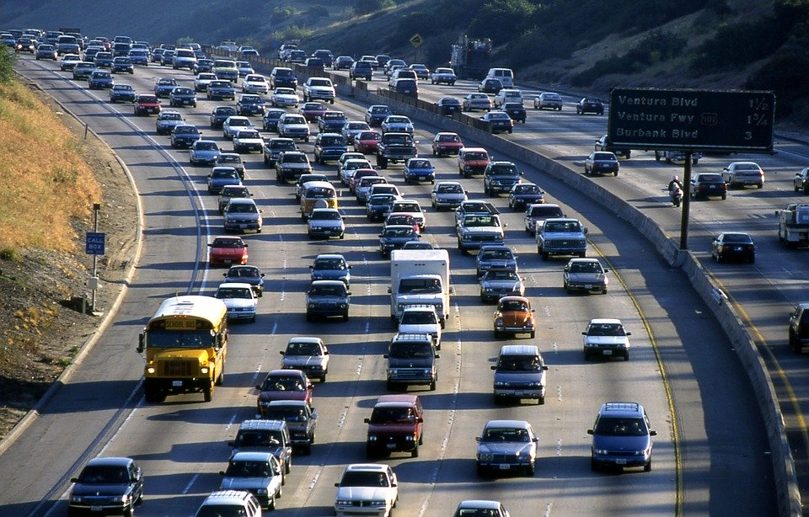
Traffic Violations in the US
Datamining Final Project
Mohammed Aljubori

Slide 2
Traffic Violations Dataset
Location: USA
Years : 2012 - 2016
Reduced from 600,000 rows to 6000
35 Columns

Slide 3
Traffic Violations Dataset
For each traffic violation, these attributes were given:
'Date Of Stop', 'Time Of Stop', 'Agency', ‘Sub Agency', 'Description',
'Location', 'Latitude', 'Longitude', 'Accident', 'Belts',
'Personal Injury', 'Property Damage', 'Fatal', 'Commercial License',
'HAZMAT', 'Commercial Vehicle', 'Alcohol', 'Work Zone', 'State',
'Vehicle Type', 'Year', 'Make', 'Model', 'Color', 'Violation Type',
'Charge', 'Article', 'Contributed To Accident', 'Race', 'Gender',
'Driver City', 'Driver State', 'DL State', 'Arrest Type',
'Geolocation’
All of the attributes are categorical, mostly strings and some Boolean only integers are the years

Slide 4
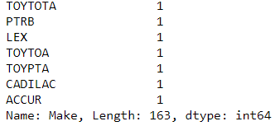
Preprocessing
First thing that was noticeable was the amount of misspelt car manufacturer names. The count for unique values was at 163 in comparison to after cleaning, which ended at 64
Preprocessing this part was a bit tricky, but in the end, no data was lost from it.

Slide 5
Preprocessing
Using df.count(), found columns with missing values, then dropped those specific rows.
Set the “Time Of Stop” values into four separate bins: 'Night’, 'Morning’, ’Afternoon’, 'Evening’.
Categorized the “Description of Violation” column into easy to read categories

Slide 6
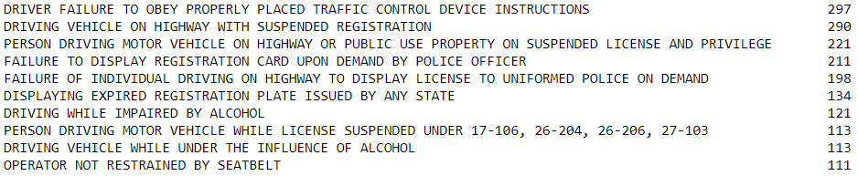
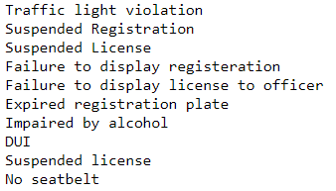
Preprocessing
Categorized the “Description of Violation” column into easy to read categories, that way an analysis can be made.

Slide 7
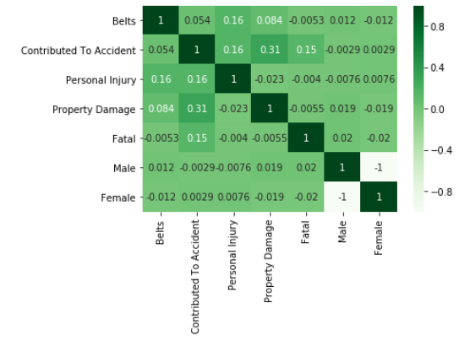
Correlation of Attributes
Positive Highlights:
Belts and Personal Injury
Personal Injury and Contributed to accident
Property damage and contributed to accident
Fatal and contributed to accident

Slide 8
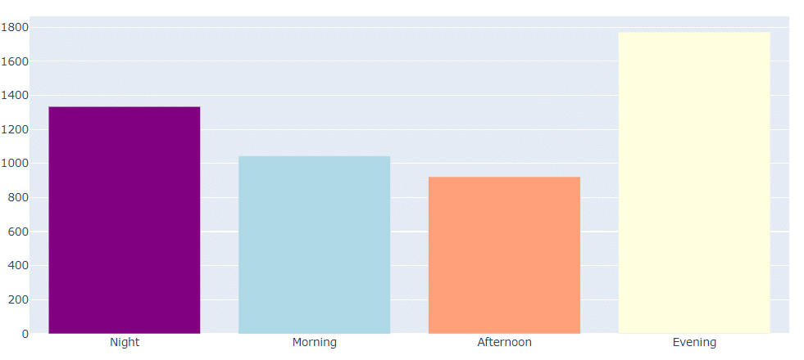
Visualizations
Traffic violation per time of day

Slide 9
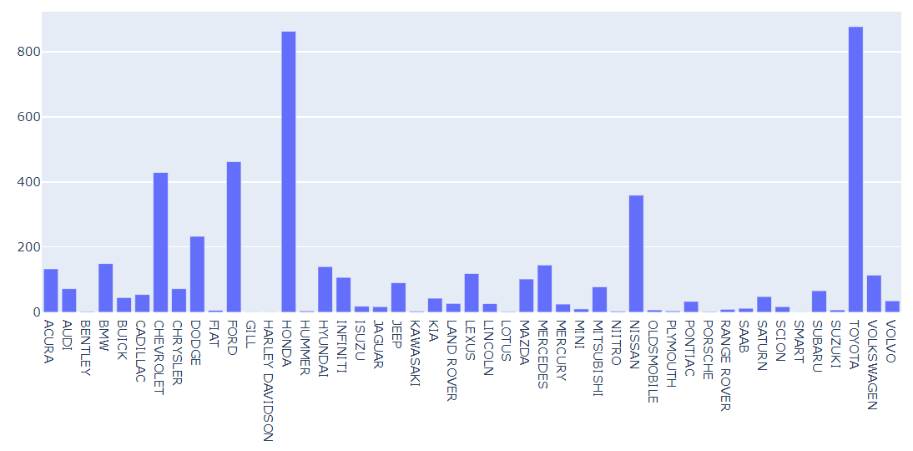
Visualizations
Bar-chart displaying traffic violation per car manufacturer

Slide 10
Visualization
Top 5 car makes that cause traffic violations (2012 – 2016) (in order) are: Toyota, Honda, Ford, Chevrolet, and Nissan.
the car brands that sold the most cars (2012 – 2016) in order are Toyota (13.7% of cars sold), Chevrolet (11.1% of cars sold), Honda (10% of cars sold), Nissan (10% of cars sold) , and Ford (9.6% of cars sold).

Slide 11
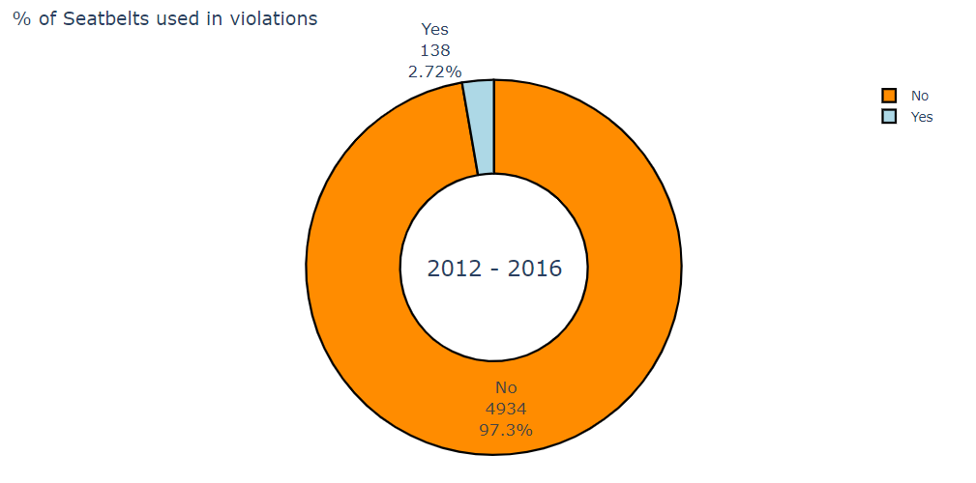
Visualization
Only 2.73 % of traffic violators in this dataset have used seatbelts when they were cited.
This makes sense because it’s an obvious assumption that if a person is violating traffic rules, they’re most likely not going to wear a seatbelt.

Slide 12
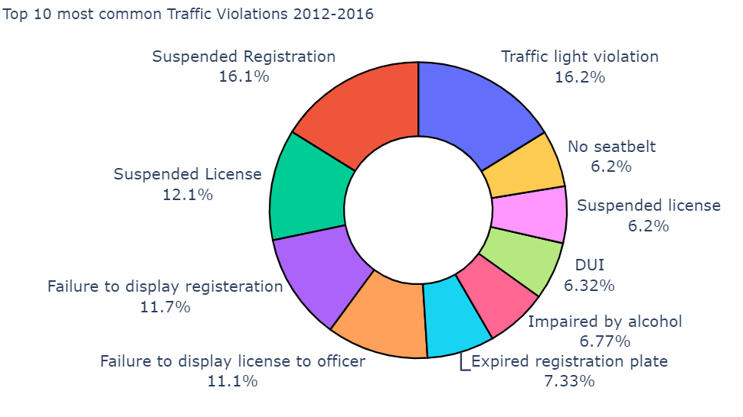
Visualization
3 Most common traffic violations are having suspended registration, traffic light violations, and having a suspended license

Slide 13
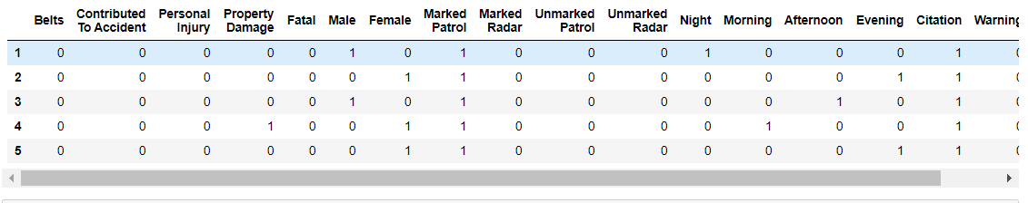
Algorithms
Finding a predictive algorithm that worked well, and a clustering algorithm, was challenging for this dataset because everything was categorical.
One way to try and go around this issue was to use an enconding method. I ended up using panda dummies on almost all of the categories except for the Boolean ones, for those I just translated them from string to binary. (Yes -> 1) (No -> 0)
Using dummies was a bit tricky because depending on the attribute, its possible for the code to make extra columns

Slide 14
Predictive Algorithm 1
For my first predictive algorithm I used Sklearn’s linear regression algorithm and Sklearn’s train_test_split
After fitting the data into the model, and running linear regression, I assessed the values using R2_score from Sklearn. The R2 score = 0.20.
(The closer the R2 Score is to 1, the better)

Slide 15
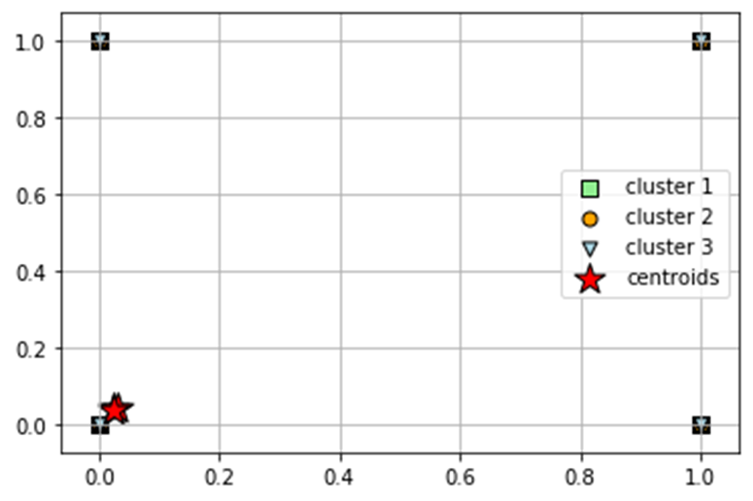
Clustering Algorithm
I could not find the correct clustering choice for this dataset, so I went with Kmeans algorithm since that is a good basic choice.
Using elbow method, clusters
used = 3
As shown in the figure, clustering
the means will not do anything
because the data is encoded into
0’s and 1’s

Slide 16
Predictive Algorithm 2
For the second predictive algorithm I used Sklearn’s Logistic Regression.
For comparison reasons, I chose the same variables as ones used in the linear regression prediction algorithm, and used the same accuracy test.
Logistic Regression yielded a 0.72, which is a lot better from last time which was 0.2

